Slide 1
Employee Data Analysis using Excel
STUDENT NAME:N. Swetha
REGISTER NO: 312201677
DEPARTMENT:Commerce
COLLEGE : Prof Dhanapalan College Of Science and Management

Slide 2
PROJECT TITLE
Employee Performance Analysis using Excel

Slide 3


AGENDA
Problem Statement
Project Overview
End Users
Our Solution and Proposition
Dataset Description
Modelling Approach
Results and Discussion
Conclusion
3/21/2024 Annual Review

Slide 4
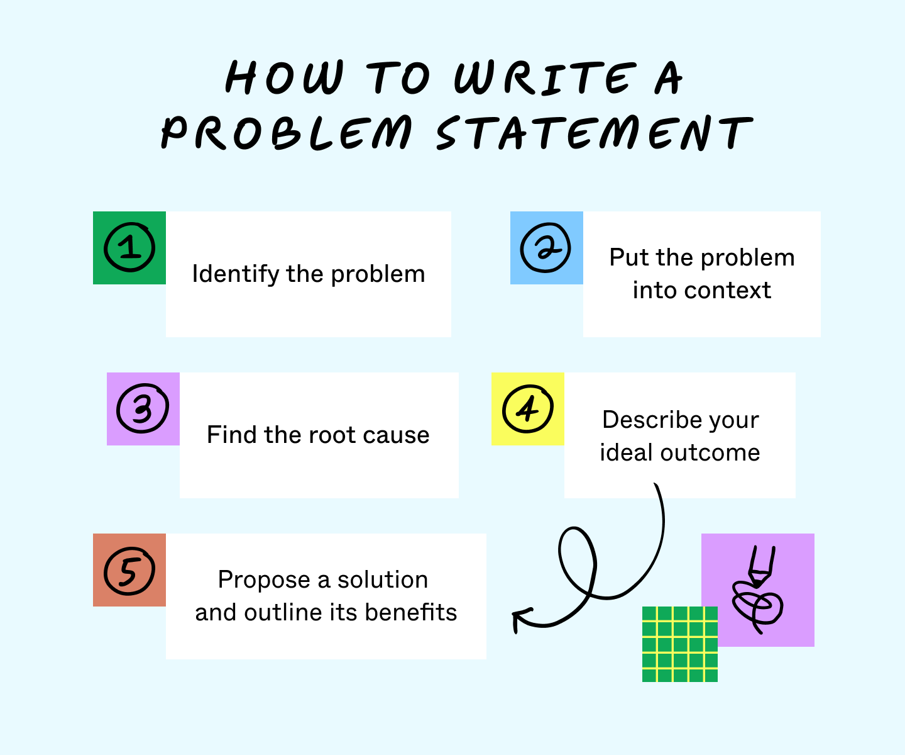

PROBLEM STATEMENT
Here's an example of a basic problem statement:Problem: Voter turnout in the southwest region of Florida has been significantly decreasing over the past decade, while other areas of the state continue to see increasing numbers of voters at the polls

Slide 5


PROJECT OVERVIEW
A project overview is a document that summarizes a project's key details in a concise, easy-to-understand way. It's a central hub for a project team, providing a comprehensive view of the project and helping everyone understand its context.
.

Slide 6


WHO ARE THE END USERS?
In product development, an end user (sometimes end-user)[a] is a person who ultimately uses or is intended to ultimately use a product.[1][2][3] The end user stands in contrast to users who support or maintain the product,[4] such as sysops, system administrators, database administrators,[5] information technology (IT) experts, software professionals, and computer technicians.

Slide 7


OUR SOLUTION AND ITS VALUE PROPOSITION
A value proposition is a statement that explains the benefits of a product or service and why a customer should choose it over competitors. It's a key part of a company's marketing strategy and helps to differentiate the brand in the market.

Slide 8
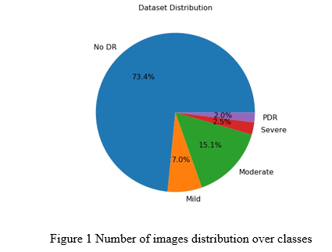
Dataset Description
A dataset is a collection of organized data that can be used for many purposes, including analysis, research, and statistical analysis.

Slide 9

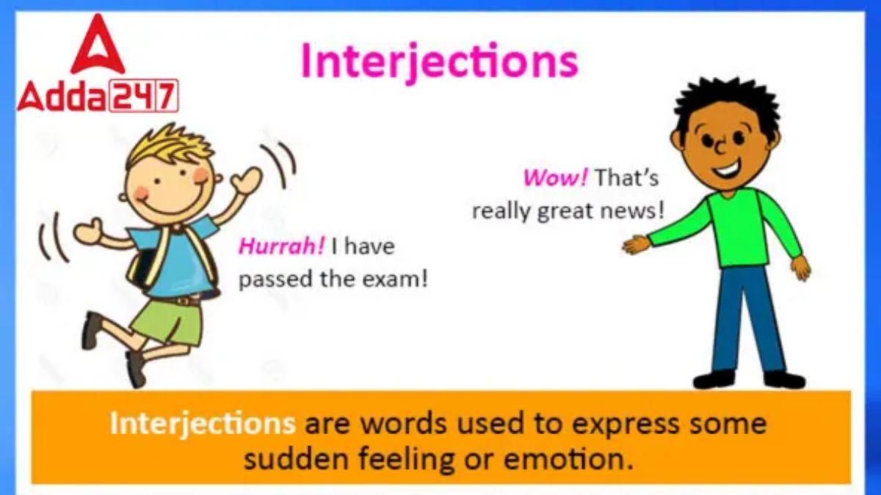
THE "WOW" IN OUR SOLUTION
The "wow" in a solution can refer to a "wow moment" or "wow experience" which is when a customer's experience exceeds their expectations:
3/21/2024 Annual Review
9

Slide 10

MODELLING
the act or activity of making small copies of things (such as planes, trains, etc.) : the hobby of making models.
10

Slide 11

RESULTS
to come about as an effect, consequence, or conclusion. disease results from infection. 2. : to have as an effect.
11

Slide 12

conclusion
A conclusion is the final piece of writing in a research paper, essay, or article that summarizes the entire work. The conclusion paragraph should restate your thesis, summarize the key supporting ideas you discussed throughout the work, and offer your final impression on the central idea

